Slide 1
Customer Lifetime Value Prediction Using Machine Learning Regression
SIMATS ENGINEERING Saveetha Institute of Medical and Technical Sciences Chennai-602105.
K.Kameshwaran 192312046 Deepan Kumar P 192312498 Anirudhan S 192312056 Shaik Arshad Basha 192312336 Thiruvenkadaprasath S 192312016
Supervisor
Dr K Baskar, Professor
Department of Computer Science and Engineering
SIMATS Engineering

Slide 2
Abstract
This project aims to predict Customer Lifetime Value (CLV) using Random Forest Regression to help businesses identify high-value customers and improve decision-making. The model uses customer data such as Age, Gender, Purchase Frequency, Total Purchase Amount, Average Order Value, Recency, and Total Revenue collected from a Kaggle dataset.
The methodology includes data collection, preprocessing, feature engineering, exploratory data analysis (EDA), model training, and evaluation using MAE, RMSE, and R² Score. The predicted CLV is used to classify customers into Gold, Silver, and Bronze segments and is displayed through a dashboard with business recommendations.
The system provides accurate CLV predictions, enabling businesses to improve customer retention, optimize marketing strategies, and make data-driven decisions.

Slide 3
Problem Statement:
Many businesses focus on short-term sales instead of understanding the long-term value of their customers, making it difficult to identify high-value customers and develop effective retention strategies. Traditional methods of estimating Customer Lifetime Value (CLV) are often inaccurate and time-consuming.
This project addresses this problem by using Machine Learning (Random Forest Regression) to accurately predict Customer Lifetime Value based on customer purchasing behavior and demographic data. The predicted CLV helps businesses segment customers, improve retention, optimize marketing efforts, and make data-driven business decisions.

Slide 4
Objectives
To design and implement a robust Random Forest Regression model capable of accurately predicting Customer Lifetime Value (CLV) by analyzing customer demographics, purchasing behavior, and transaction history, enabling precise long-term revenue forecasting and strategic business planning.
To develop an intelligent customer segmentation and recommendation system that classifies customers into Gold, Silver, and Bronze categories, delivers personalized retention strategies, optimizes marketing resource allocation, increases customer loyalty, and maximizes overall business growth and profitability through data-driven decision-making.

Slide 5
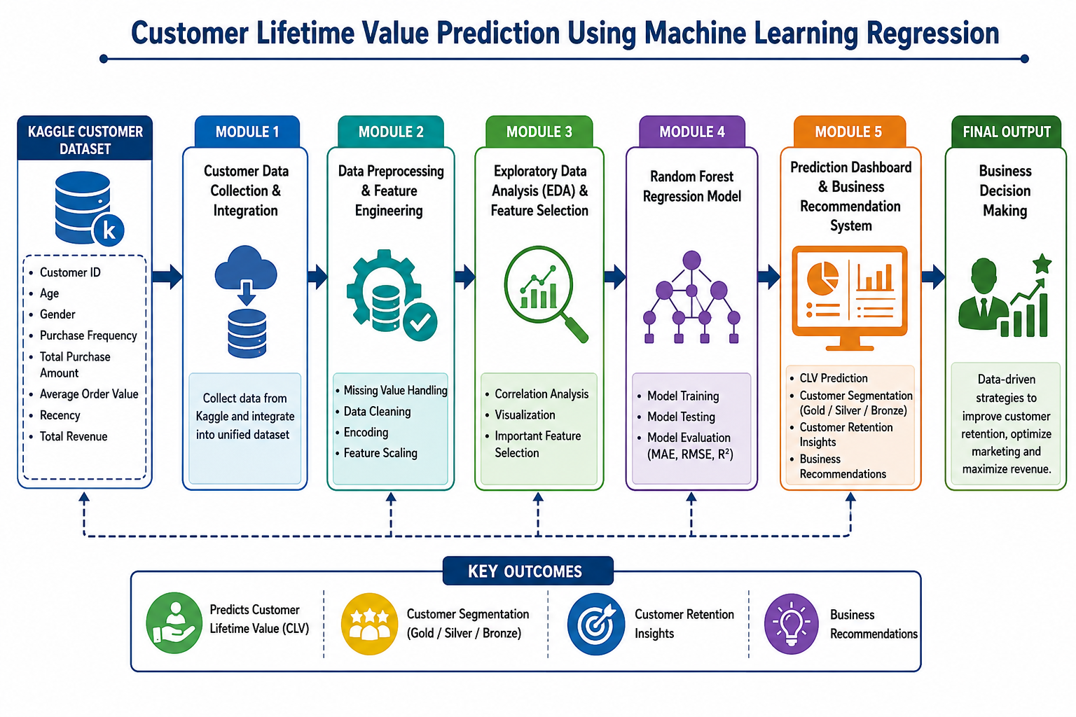
System Architecture / Workflow

Slide 6
Module 1: Customer Data Collection and integration
This module focuses on collecting customer information from the Kaggle dataset and integrating it into a unified, structured format. The input includes customer details such as Customer ID, Age, Gender, Purchase Frequency, Total Purchase Amount, Average Order Value, Recency, and Total Revenue. These attributes provide the foundation for analyzing customer behavior and predicting Customer Lifetime Value (CLV).
The output of this module is a complete and well-organized customer dataset that is ready for the Data Preprocessing and Feature Engineering stage. By ensuring data consistency and proper integration, this module establishes a reliable foundation for accurate machine learning model training, customer segmentation, and business recommendation generation.

Slide 7
Module 2: Data Preprocessing and Feature Engineering
This module prepares the integrated customer dataset for machine learning by cleaning and transforming the data into a suitable format. The input is the structured dataset generated from Module 1, containing customer attributes such as Age, Gender, Purchase Frequency, Total Purchase Amount, Average Order Value, Recency, and Total Revenue. Data preprocessing techniques including missing value handling, duplicate removal, categorical encoding, feature scaling, and feature engineering are applied to improve data quality and model performance.
The output of this module is a clean, normalized, and feature-enhanced dataset that is ready for Exploratory Data Analysis (EDA) and feature selection. By eliminating inconsistencies and creating meaningful features, this module improves the accuracy, reliability, and efficiency of the Random Forest Regression model used for Customer Lifetime Value prediction.

Slide 8
Module 3:Exploratory Data Analysis and Feature Selection
This module analyzes the preprocessed customer dataset to identify patterns, relationships, and the most influential features affecting Customer Lifetime Value (CLV). The input is the cleaned and feature-engineered dataset from Module 2. Various EDA techniques such as data visualization, correlation analysis, distribution analysis, and feature importance evaluation are performed to understand customer behavior and select the most relevant attributes for model training.
The output of this module is an optimized dataset containing the most significant features for predicting CLV. By removing irrelevant or less important attributes and highlighting meaningful patterns, this module improves the efficiency, accuracy, and predictive performance of the Random Forest Regression model in the next stage.

Slide 9
Module 4: Customer Lifetime value Prediction using Random Forest Regression
This module develops and trains the Random Forest Regression model to predict Customer Lifetime Value (CLV) using the optimized dataset obtained from Module 3. The input consists of the selected customer features, including Age, Gender, Purchase Frequency, Total Purchase Amount, Average Order Value, Recency, and Total Revenue. The model is trained and tested, and its performance is evaluated using Mean Absolute Error (MAE), Root Mean Squared Error (RMSE), and R² Score to ensure accurate and reliable predictions.
The output of this module is the predicted Customer Lifetime Value (CLV) for each customer along with a validated machine learning model. These predictions are then forwarded to the Prediction Dashboard and Business Recommendation System, where customers are segmented into Gold, Silver, and Bronze categories to support business decision-making and customer retention strategies.

Slide 10
Module 5: Prediction Dashboard and Business Recommendation System
This module presents the predicted Customer Lifetime Value (CLV) in an interactive dashboard and converts the prediction results into meaningful business insights. The input consists of the predicted CLV values generated by the Random Forest Regression model. Based on these predictions, customers are classified into Gold, Silver, and Bronze segments, and key metrics are visualized through charts, graphs, and summary reports to simplify analysis.
The output of this module is a prediction dashboard displaying CLV results, customer segments, retention insights, and personalized business recommendations. This module enables businesses to identify high-value customers, improve customer retention strategies, optimize marketing campaigns, and make informed, data-driven decisions that enhance long-term profitability and customer satisfaction.

Slide 11
Conclusion & Future Work
This project successfully predicts Customer Lifetime Value (CLV) using Random Forest Regression based on customer demographic and purchase data. The system accurately segments customers into Gold, Silver, and Bronze categories and provides business recommendations, helping organizations improve customer retention and make data-driven decisions.
The system can be enhanced by integrating real-time customer data, implementing advanced models such as XGBoost and Deep Learning, and adding features like customer churn prediction, personalized recommendations, and cloud-based deployment for improved scalability and accuracy.

Slide 12
References
[1] Y. Yan and N. Resnick, “A Data-Driven Approach to Customer Lifetime Value Prediction Using Probability and Machine Learning Models,” Data Analytics Journal, vol. 3, Art. no. 100601, Elsevier, 2025.
[2] L. Taherkhani, A. Daneshvar, H. Amoozad Khalili, and M. R. Sanaei, “Analysis and Optimization of Customer Lifetime Value Prediction Using Machine Learning and Deep Learning Models by RFM Techniques,” International Journal of Web Research, vol. 8, no. 2, pp. 79–92, Apr. 2025.
[3] “Machine Learning for Predicting Customer Lifetime Value in Retail,” Canadian Journal of Marketing Research, vol. 14, no. 3, Oct. 2024.
[4] Y. Yan and N. Resnick, “A High-Performance Turnkey System for Customer Lifetime Value Prediction in Retail Brands,” Quantitative Marketing and Economics, vol. 22, pp. 169–192, 2024.

